Slide 1
Image Classification Project- Deep Learning

Slide 2
Problem Statement
Images are one of the major sources of data in the field of data science and AI. This field is making appropriate use of information that can be gathered through images by examining its features and details. So here we are working on this project in 2 phases:
1) Data Collection: I collected images of saree, trousers and jeans from amazon.com.
2) Analysing the image and building the model.

Slide 3
Data Source and format
We collected approx 400 images of each class saree, trousers and jeans from amazon.com in the jpg format and saved each class images in there respective folders . Further all the categorical folders are saved in image_classifier folder.

Slide 4
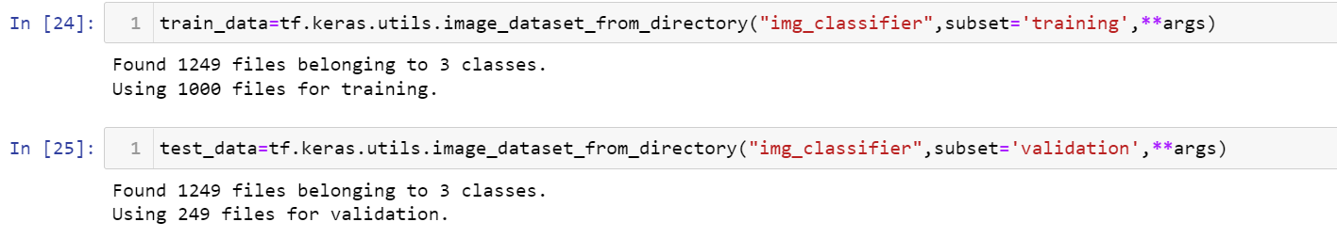
Data Preprocessing
The dataset is divided into training set and testing set.
Here args is a set of following parameters:

Slide 5
Further we prefetched the training and testing data from hard disk to cache for faster processing.

Slide 6
Hardware and Software used
We imported following packages:
import tensorflow as tf
from PIL import Image
from tensorflow.keras import layers
from tensorflow.keras.models import Sequential
import pandas as pd
import numpy as np
import itertools
import base64
import iofrom sklearn.feature_extraction.text import TfidfVectorizer
import warnings
warnings.filterwarnings('ignore')
from nltk.stem import WordNetLemmatizer
import nltk
from nltk.corpus import stopwords
import string

Slide 7
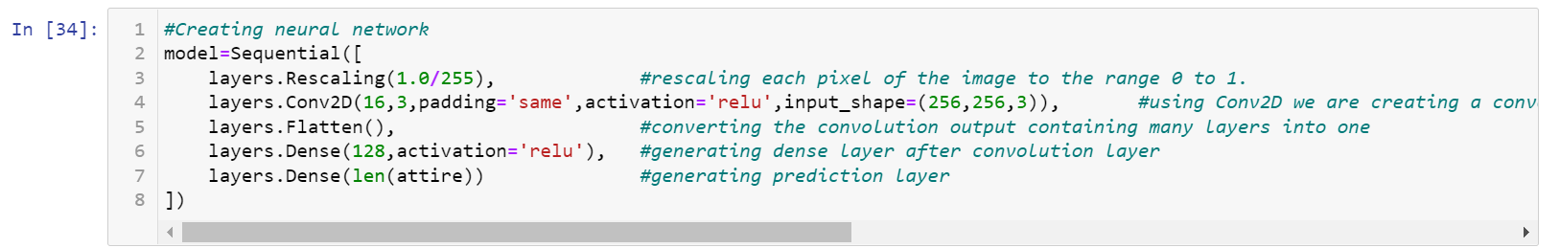
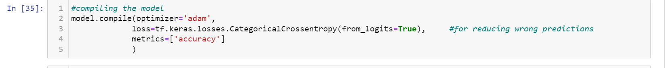
Neural Network and model Building
We applied CNN algorithm and build a neural network of 2 layers a convolution layer and a dense layer.
Further we compiled the model to reduce loss by using keras module categorical crossentropy method.

Slide 8
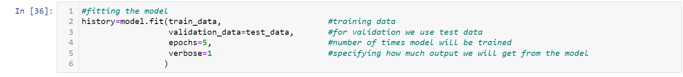
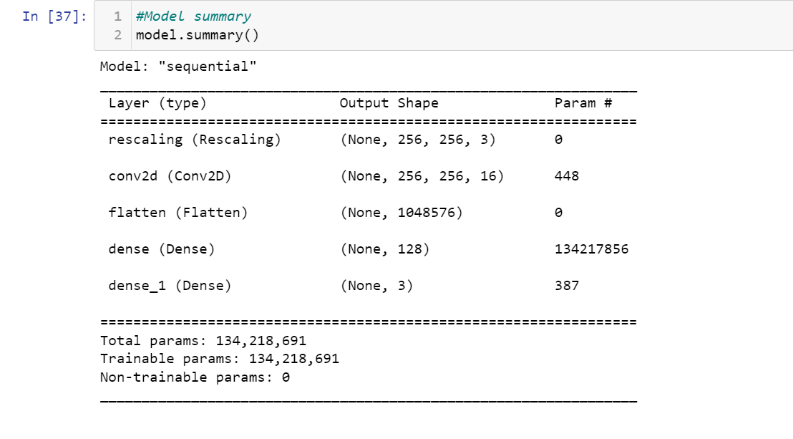
Then the model was trained with training data with epochs as 5.
Here is the model summary, it has 5 layers for rescaling the image, convolution layer, flattening the image and then two dense layers:

Slide 9
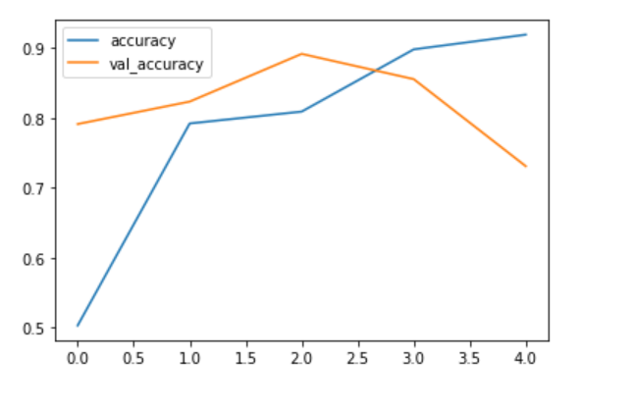
We checked the performance and concluded that the model is overfitting as in the last epoch training accuracy is 91% and testing accuracy is 73%.

Slide 10
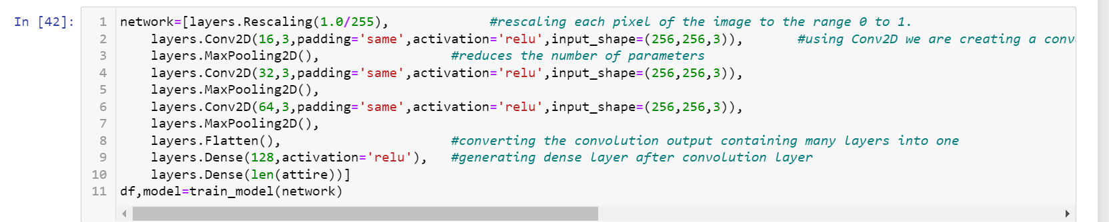
In order to increase accuracy and remove the problem of overfitting we added more layers to our
neural network with higher feature extraction from images.

Slide 11
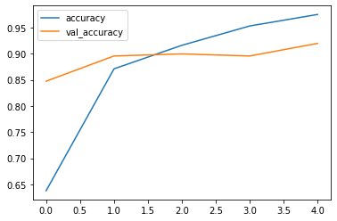
This neural network removed overfitting problem and increases model accuracy to 91%.

Slide 12
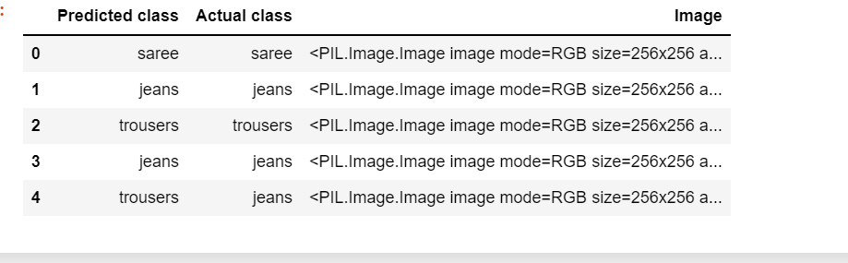
Later on we used this model to make predictions and here is the glimpse of predicted and true value.

